Slide 1
OCCDS - ADaM Structure for Occurrence Data
Anagha Bhatkhande Varsha Mahajan
V 1.0
Effective date: 01-Nov-2017
Copyright © 2016 Tata Consultancy Services Limited
Notes:
Title Slide
Theme Image area
We need to place appropriate image based on the content of the Presentation
Version No
Release date
PALS logo
TCS logo
Theme 1-a
Align text to the bottom of the logo bottom line
Font size 10pt

Slide 2


Confidentiality Statement
This document contains information which is commercially confidential to Tata Consultancy Services Ltd. ("TCS") and is provided for the sole purpose of permitting the recipient to evaluate the proposal submitted within the document. In consideration of the receipt of this document, the recipient agrees to maintain the information it contains in confidence and not to reproduce or otherwise disclose the contents of this document to any person outside the recipient's evaluation team or nominated advisors. The document may not be used, reproduced or disclosed to others, except as specifically permitted by TCS in writing. The recipient of this document, by its retention and use, agrees to take reasonable endeavours to protect the document and the information it contains from loss or theft.
© 2017 - TATA Consultancy Services Limited (TCS)
TCS confidential

Slide 3
Data Structure
General data structure and content typically found in occurrence analysis.
Occurrence analysis is the counting of subjects with a given record or term, and often includes a structured hierarchy of dictionary coding categories.
Examples: Adverse Events, Concomitant Medications, and Medical History.

Slide 4
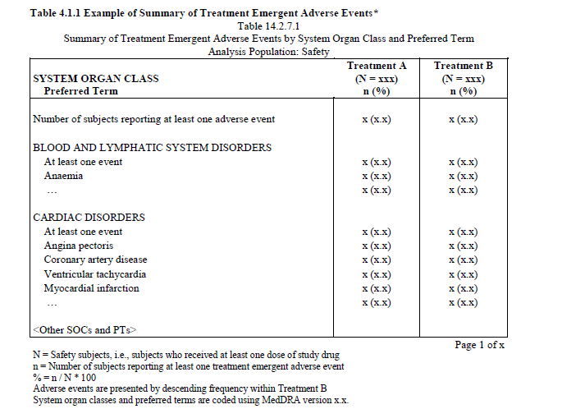
What is Treatment emergent AE?
The overall definition of a TEAE is given in the GCP ICH E9 guideline and is considered in all cases:
“An event that emerges during treatment having been absent pre-treatment, or worsens relative to the pre-treatment state.”
The first question is about the understanding of “during treatment” in the study?
This must be clearly defined in the clinical study protocol or SAP
Usually the “during treatment” period is the period which starts with the first treatment exposure and stops after a predefined post-treatment time window.
The post-treatment time window considers the time to clear the body from the drug and depends on the pharmacological characteristics of the substance studied
Do I have this info in SDTM AE?

Slide 5
Create the table to show AEs in Pre-Treatment period

Slide 6
Table Programming
To create the tables discussed in earlier slides let’s understand what variables do we need and from where can we get them?
Population Flag – ADSL
Treatment Variables –ADSL
SOC – SDTM AE
PT- SDTM AE
Treatment emergent flag – Need to create
Pre-treatment flag
Steps:-
Need to merge SDTM AE and ADSL
Derive the treatment emergent flag in program for Table1
Derive the Pre-treatment flag in program for Table 2
Is this an efficient way to do the programming?

Slide 7
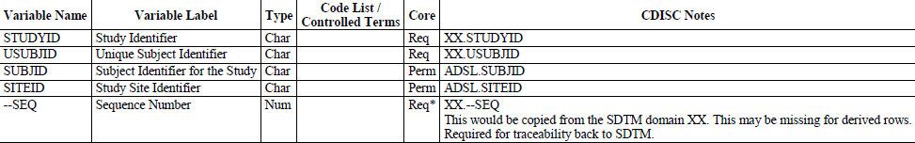
OCCDS : Variable Metadata
Identifier Variables
ADSL Variables
Merge ADSL variables needed for analysis or reference.
Be aware that only subjects with an SDTM record would have an analysis record.
Thus it is recommended to select population indicators and denominator counts for percentages derived from ADSL and not from the occurrence analysis dataset

Slide 8
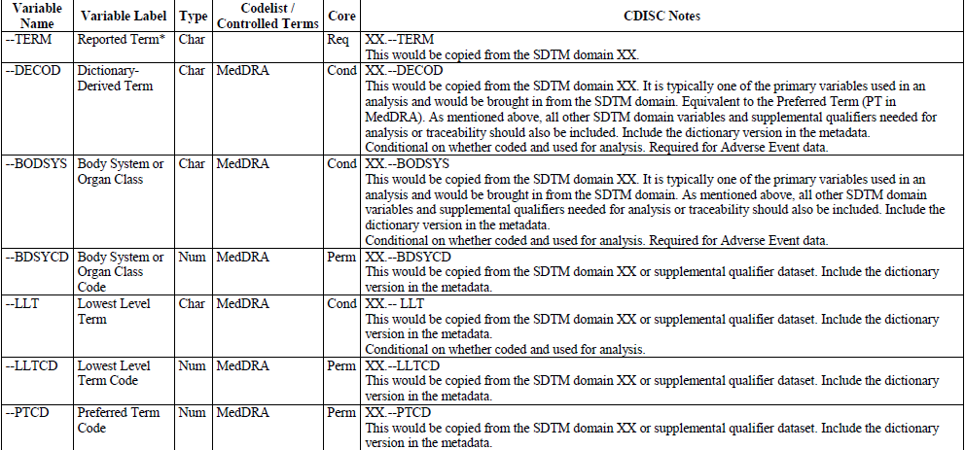
OCCDS : Variable Metadata
variable label differs depending on the SDTM domain
Dictionary Coding and Categorization Variables
TCS confidential

Slide 9
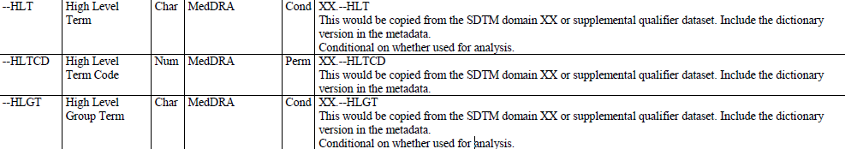
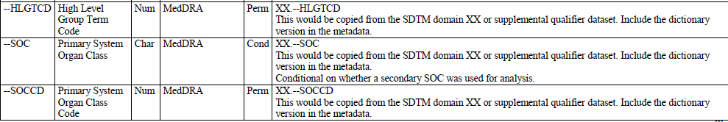
OCCDS : Variable Metadata
Dictionary Coding and Categorization Variables
TCS confidential
Notes:
NOTE: MedDRA allows for secondary paths for Lower Level Terms. One may be required to report on secondary paths along with primary paths. Please see section 8for an example layout for one possible way to handle this analysis need.

Slide 10
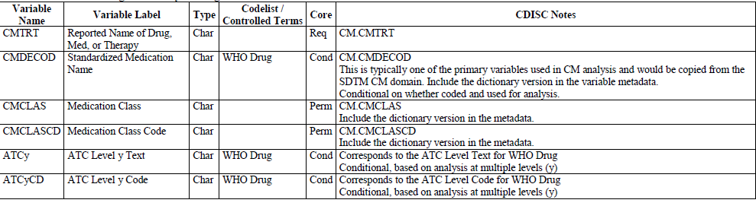
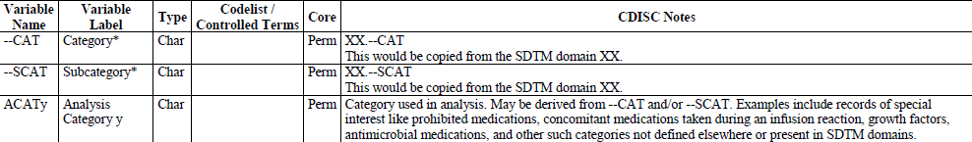
OCCDS : Variable Metadata
WHO Drug Dictionary Coding Variables
Other Categorization Variables
When categories are used for the intended analysis, instead of or in addition to MedDRA or WHO Drug, these generic categorization variables are commonly used:
TCS confidential

Slide 11
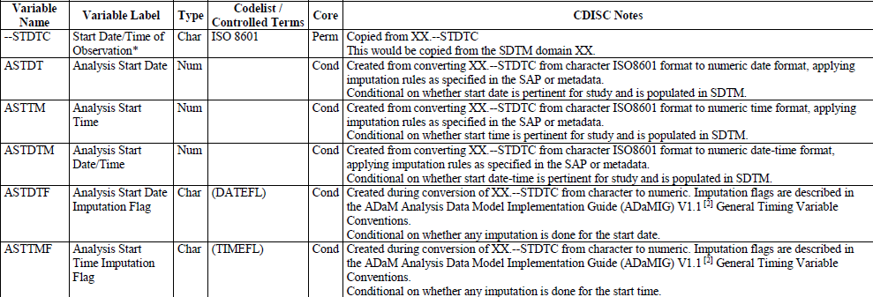
OCCDS : Variable Metadata
Timing Variables
Notes:
Timing variables are copied from SDTM and derived within ADaM.
Included below are the common timing variables. If other timing variables are collected in SDTM and pertinent for analysis, these should be included in ADaM.
Additional timing variables, such as those for analysis period or phase, can be included.

Slide 12
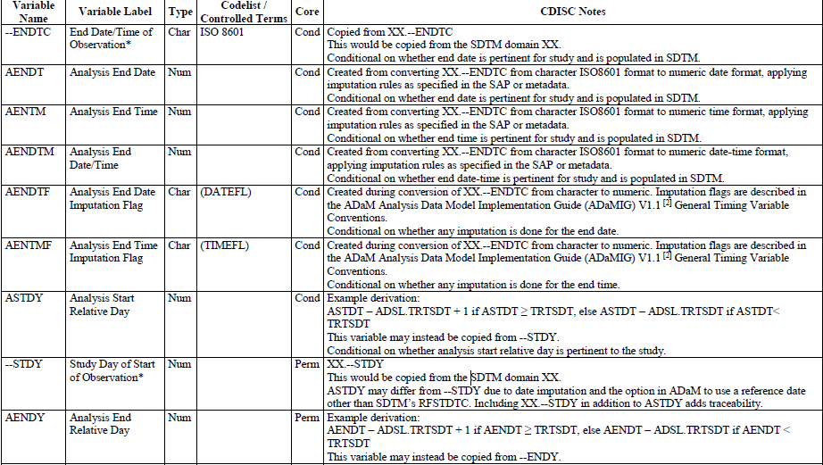
OCCDS : Variable Metadata
Timing Variables
Notes:
Timing variables are copied from SDTM and derived within ADaM.
Included below are the common timing variables. If other timing variables are collected in SDTM and pertinent for analysis, these should be included in ADaM.
Additional timing variables, such as those for analysis period or phase, can be included.

Slide 13
OCCDS : Variable Metadata
Timing Variables
Notes:
Timing variables are copied from SDTM and derived within ADaM.
Included below are the common timing variables. If other timing variables are collected in SDTM and pertinent for analysis, these should be included in ADaM.
Additional timing variables, such as those for analysis period or phase, can be included.

Slide 14
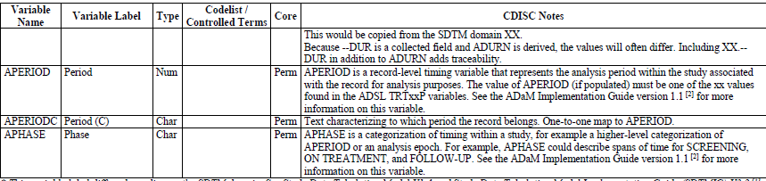
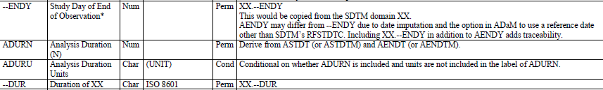
OCCDS : Variable Metadata
Timing Variables
Notes:
Timing variables are copied from SDTM and derived within ADaM.
Included below are the common timing variables. If other timing variables are collected in SDTM and pertinent for analysis, these should be included in ADaM.
Additional timing variables, such as those for analysis period or phase, can be included.

Slide 15
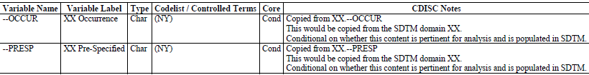
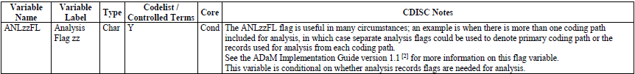
OCCDS : Variable Metadata
Indicator Variables
Notes:
Timing variables are copied from SDTM and derived within ADaM.
Included below are the common timing variables. If other timing variables are collected in SDTM and pertinent for analysis, these should be included in ADaM.
Additional timing variables, such as those for analysis period or phase, can be included.

Slide 16
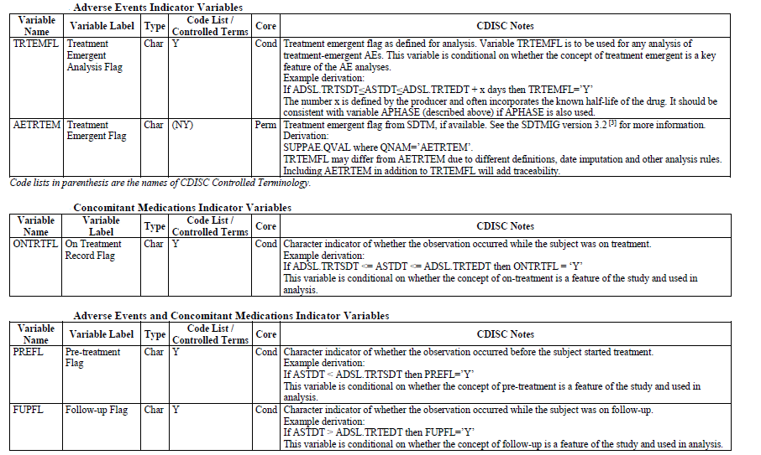
Indicator Variables

Slide 17
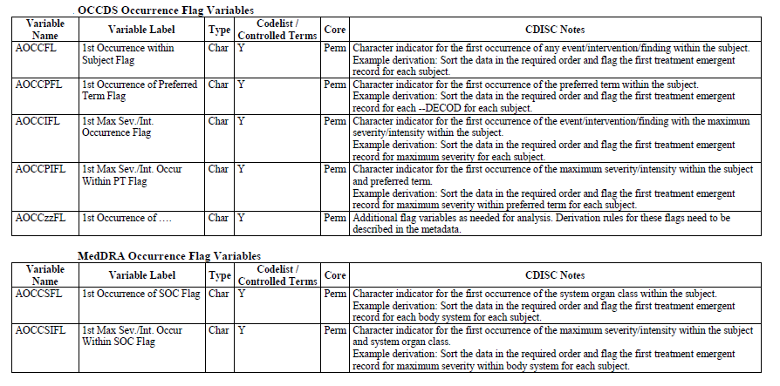
Occurrence Flag Variables

Slide 18
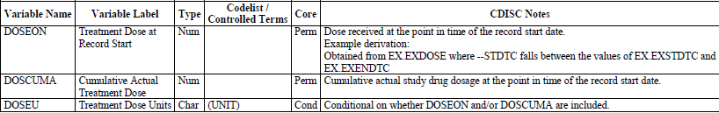
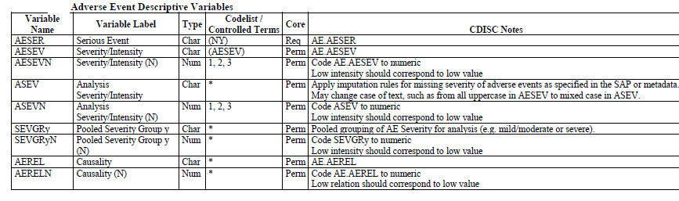
Treatment/Dose Variables
Descriptive Variables for AE

Slide 19
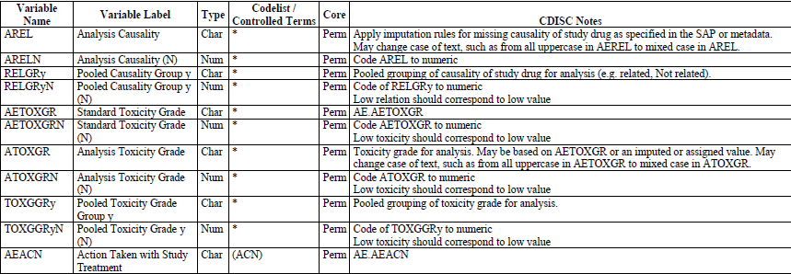
Descriptive Variables for AE
Medical History data typically does not contain descriptive variables. If needed for analysis, use variables as shown above for Adverse Events, replacing the prefix “AE” with “MH”.

Slide 20
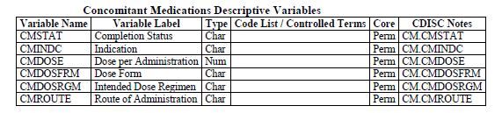
Descriptive Variables for CM

Slide 22
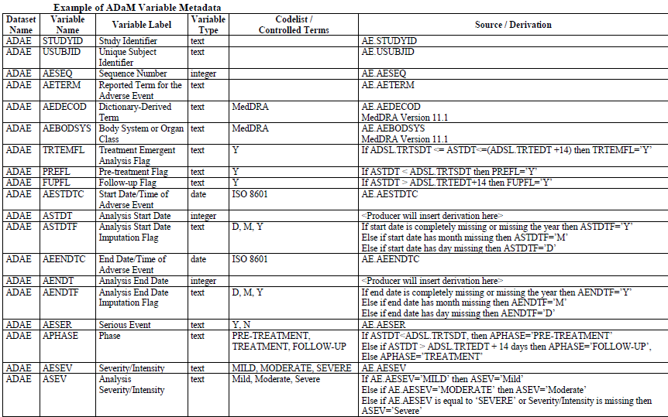
Sample ADaM dataset for creating report
Indicator Variables
Dictionary Coding and Categorization Variables
AE Indicator Variables
Time Variables
Descriptive
Variables

Slide 23
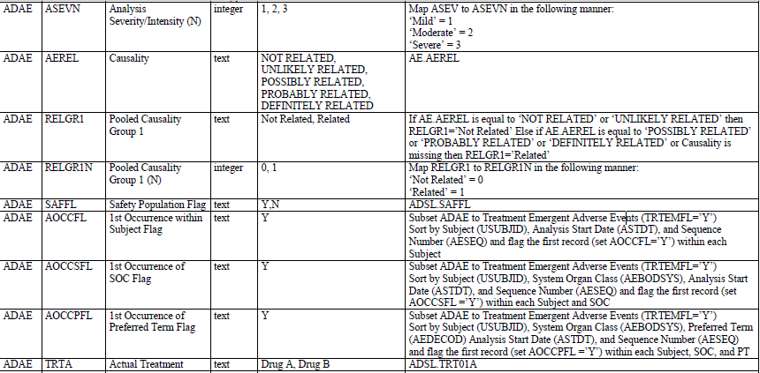
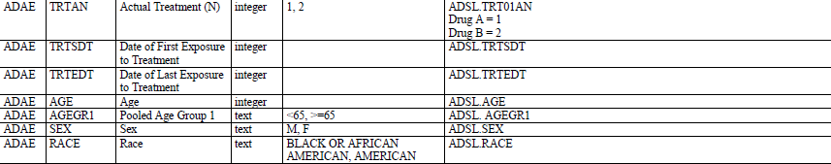
Grouping variables
Occurrence Flag
variables
Treatment Variables

Slide 24
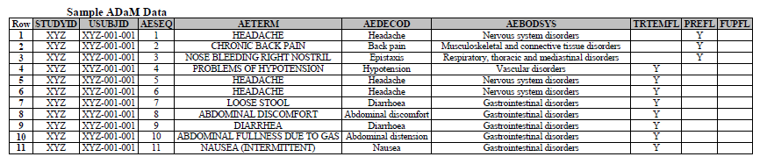
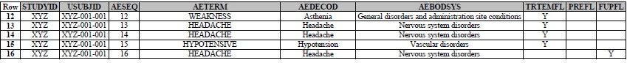

Slide 25
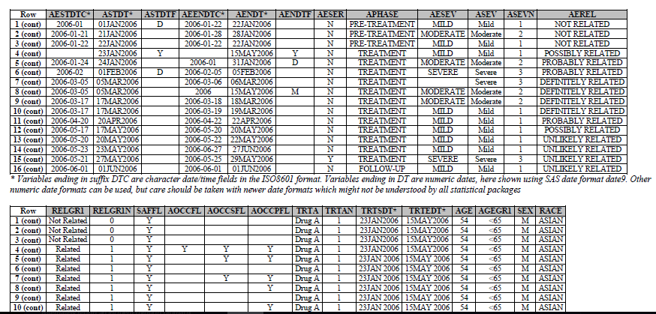

Slide 26
Thank You
For any feedback/comment/clarification please contact us at PALS@tcs.com
V NN

Slide 27
Document Release Notice
This XXXXXXX, Version NN, is released for use in Tata Consultancy Services (TCS) with effect from – DD-Mmm-YYYY.
This Training Material is subject to TCS Document Control Procedure. TCS reserves the right to make additions, modifications or alterations to the existing content or release a newer version of this document.
Softcopy of the latest version of the document is available in the ABCDEFG
Comments suggestions or queries should be addressed to PALS@tcs.com.
Date: DD-Mmm-YYYY
Date: DD-Mmm-YYYY
Document Name
Effective Date: DD-MMM-YYYY
V NN
Notes:
Font size 9pt

Slide 28
Change/Revision History
Version No. | Revision Description | Slide No. | Rationale for the Change | Change type (Add/Modify/Delete) | Modified By | Date Modified (DD-Mmm-YYYY)
V NN

